Slide 1

Hands-On With Monte Carlo Simulations
Mohammad Soroush Barhaghi†, Younes Nejahi‡, Loren Schwiebert‡, and Jeffrey Potoff†
† Department of Chemical Engineering & Materials Science, College of Engineering,
‡ Department of Computer Science, College of Engineering, Wayne State University, Detroit, MI,
USA 48202
Notes:
1- MC simulation engine
2- Developed by potoff group & schwibert
3- Developed for running on CPU and GPU
4- CPU system size < 10,000
5- GPU system size > 10,000

Slide 2
Tutorial files
On GitHub
Git clone https://github.com/ GOMC-WSU /Workshop.git
Website https://github.com/GOMC-WSU/Workshop/tree/AIChE2019
To run example: change the directory to ~/GOMC-Workshop/

Slide 3
Overview
Grand canonical Monte Carlo simulation
Adsorption of Ar and CO₂ in IRMOF-1
System setup for adsorption in porous materials, using automated HTS tools
Modify the XML input file to HTS tools
Add new adsorbate molecule
Extract the simulation results
Canonical Monte Carlo simulation.
Solvation free energy of Ne, and Ar in cyclohexane
System setup for free energy calculation
Define the lambda states and soft-core parameters
Calculate the solvation free energy with TI and FEP estimators

Slide 4
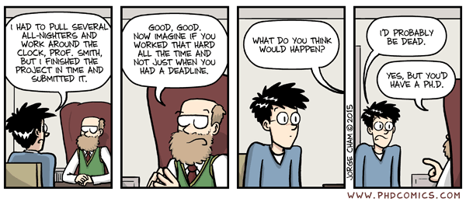
Acknowledgements
Jason Mick, Younes Nejahi, Kamel Rushaidat, Niloofar Torabi, Brock Jackman, Navendu Bhatnagar, Ganesh Kamath, Loren Schwiebert
National Science Foundation CBET-1066661, ACI-1148168, OAC-1642406
NVIDIA, Silicon Mechanics
Grid Computing at WSU

Slide 5
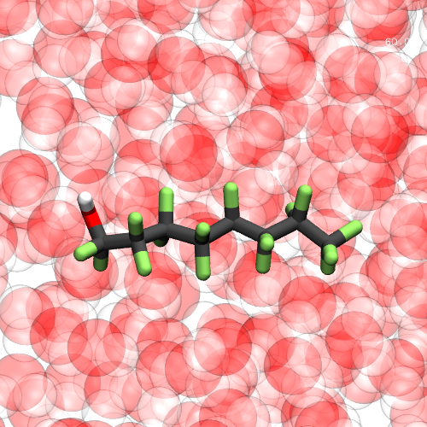
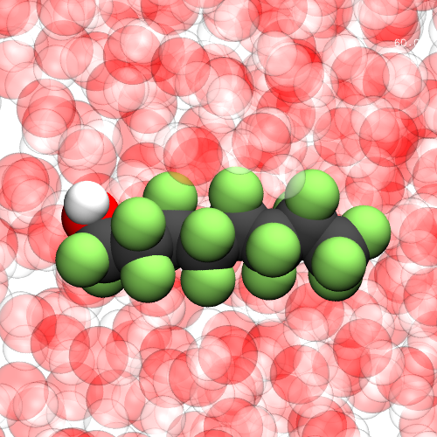

Introduction to GOMC

Slide 6
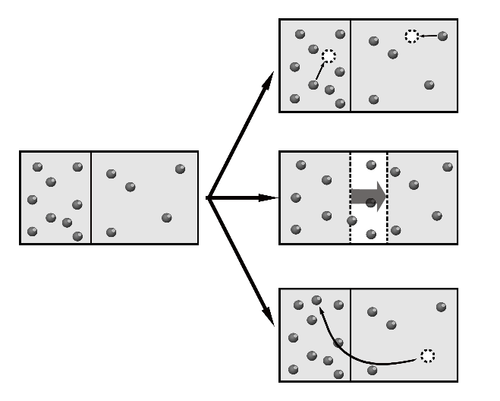
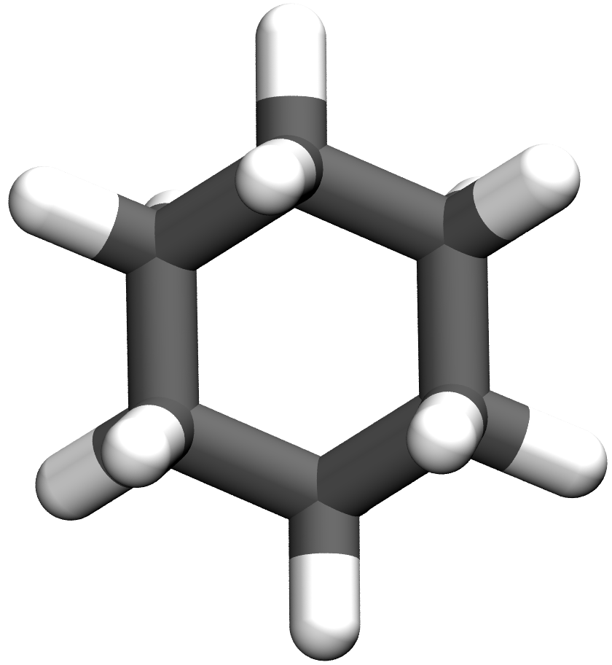
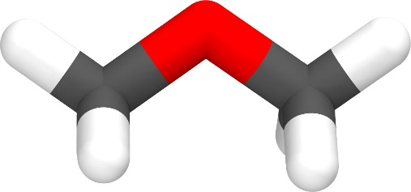
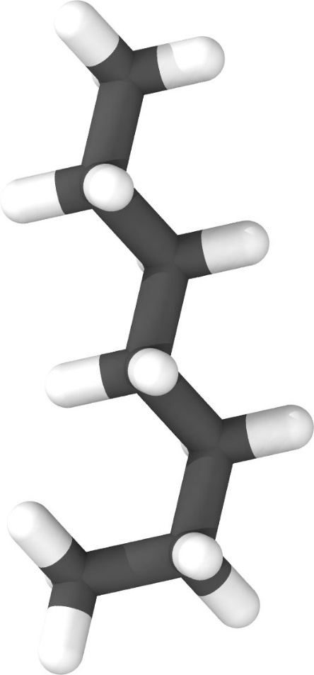
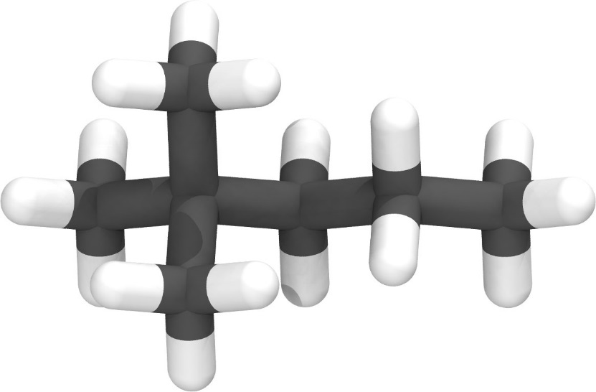

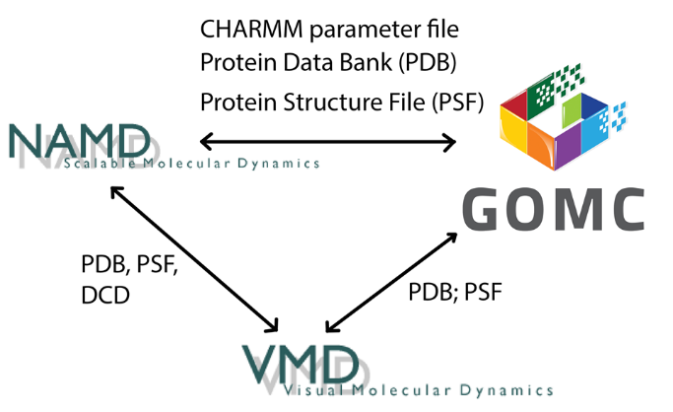
NVT, NPT, GCMC,
and GEMC
Linear, Branched, cyclic, and Polar molecules
Martini
Charmm
OPLS
Mie
Exp-6
Moves Supported:
Displacement
Rotation
Swap; Intra-swap (CD-CBMC)
Regrowth (CD-CBMC)
MEMC (inter/intra)
Multi-particle move
Free energy calculations
Volume (isotropic, anisotropic)
Parallelization
CPU
OpenMP
GPU
OpenMP + GPU

Slide 7
GOMC I/O
PDB
PDB
PSF
PSF
Log
Parameter
Block Averages
Control
GCMC: Histogram

Slide 8
GOMC I/O: Input
PDB
Coordinates of all atoms
PSF
Connectivity between atoms and partial charges.
Maps atom names to atom types
Parameter
Bonded and non-bonded parameters for all atoms,
bonds, angles and dihedrals
Control
Simulation run conditions: box size, temperature
Move ratios, parameter files, etc.

Slide 9
Generating PDB file
Single molecule
PDB file
PACKMOL
Packed molecule
PDB file
Packing information:
Num. molecule
Box size

Slide 10
Generating PSF file
Packed molecule
PDB file
VMD
PDB and PSF file
Topology file :
Atom type, charge
bonds

Slide 11
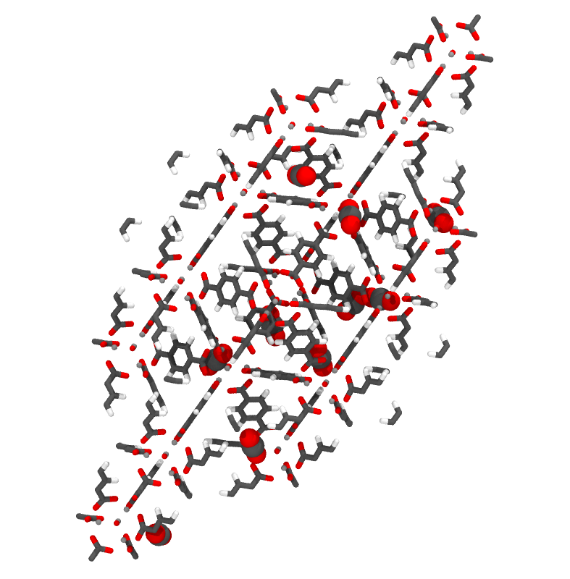
Grand Canonical Monte Carlo Example

Slide 12
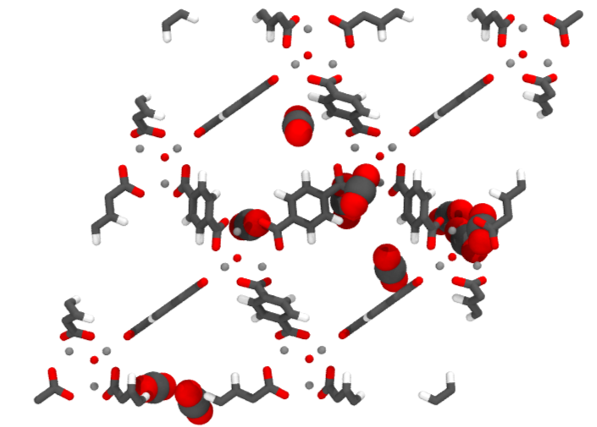
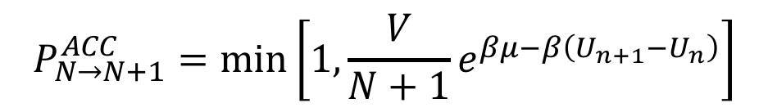
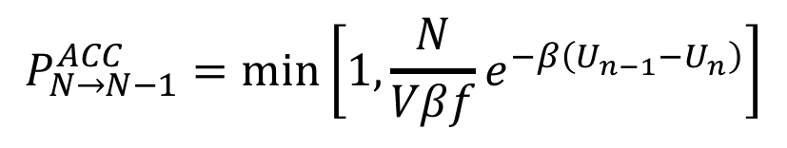
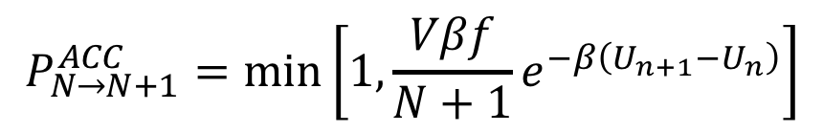
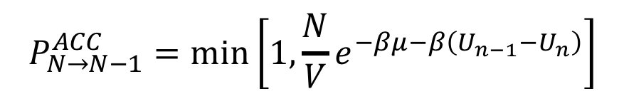
Grand Canonical Monte Carlo
Acceptance criteria for molecule swap in Grand Canonical ensemble Monte Carlo (GCMC).
Chemical Potential (K)
$$P_{N→N+1}^{ACC}=\min\left[1, {\frac{V}{N+1}e}^{βμ−β\left(U_{n+1}−U_{n}\right)}\right]$$
$$P_{N→N−1}^{ACC}=\min\left[1, {\frac{N}{V}e}^{−βμ−β\left(U_{n−1}−U_{n}\right)}\right]$$
Fugacity (bar)
$$P_{N→N+1}^{ACC}=\min\left[1, {\frac{Vβf}{N+1}e}^{−β\left(U_{n+1}−U_{n}\right)}\right]$$
$$P_{N→N−1}^{ACC}=\min\left[1, {\frac{N}{Vβf}e}^{−β\left(U_{n−1}−U_{n}\right)}\right]$$

Slide 13
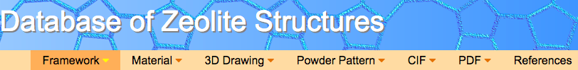

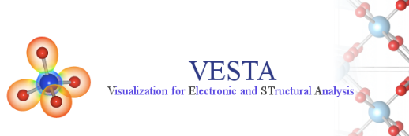
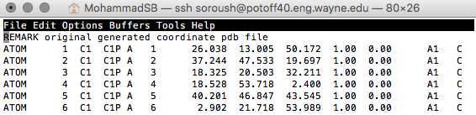
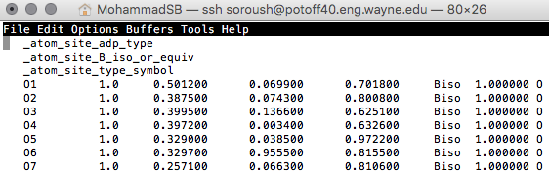
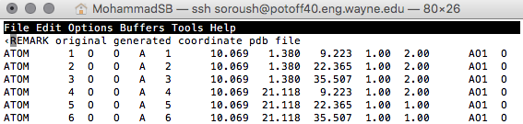
Creating PDB/PSF for adsorbent, manually:
AIChE 2018 workshop: https://github.com/GOMC-WSU/Workshop
Beta = 0: Displace, Rotate, Intra-swap, Swap, regrowth
Beta = 1: Fix position
Beta = 2: Displace, Rotate, Intra-swap, regrowth
Beta Value
Tcl script in VMD
Notes:
Tell them how hard it is to setup the simulation for adsorption manually.

Slide 14
Creating adsorption simulation file, automatically:
HTS
XML input file
Computation-Ready, Experimental Metal–Organic Frameworks: A Tool To Enable High-Throughput Screening of Nanoporous Crystals, Chem. Mater. 2014, 26, 21, 6185-6192
Notes:
More than 5000 MOFs

Slide 15
Read CIF file and generate PDB, PSF for MOFs:
_cell_length_a 18.26599998
_cell_length_b 18.26600037
_cell_length_c 18.26600000
_cell_angle_alpha 60.00000067
_cell_angle_beta 59.99999996
_cell_angle_gamma 60.00000068
Zn 0.29338 0.29338 0.29338 1.103633
Zn 0.29338 0.29338 0.11986 1.103633
H 0.1546 0.4552 0.4552 0.115883
H 0.4552 0.1546 0.935 0.115883
C 0.0927 0.4731 0.4731 -0.055959
C 0.4731 0.0927 0.9611 -0.055959
Reading the cell dimension
Calculate the cell basis vectors
Calculate the min. cell extension using the cutoff value
HTS
Extend the unit cell
Create the PDB file for MOFs
Detect the unique atom charges
Create the topology for MOFs
Create the PSB file for MOFs
Notes:
Charge are DFT-optimized in ddec

Slide 16
HTS XML input file
System: General information of the system
Model name
Adsorbent information (HTS or single adsorption)
Adsorbate information (Reservoir information)
Simulation: Simulation parameters that are fixed for all runs
MC steps
LJ and coulomb cutoff
Electrostatic calculation parameters
GOMC outputs frequency
Run simulation: Simulation parameters that are flexible for each runs
Temperature
Fugacity
XML input file

Slide 17
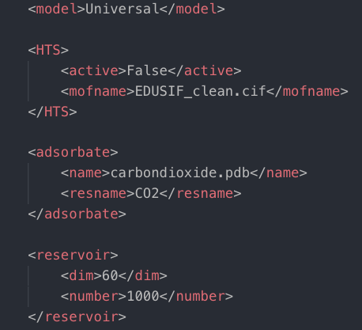
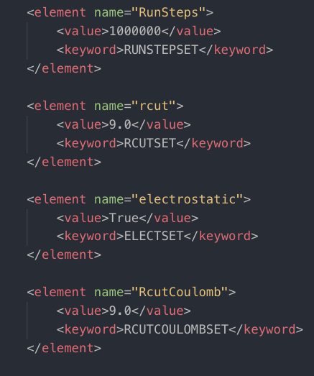
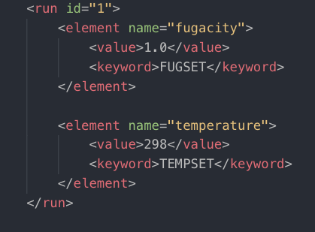
HTS XML input file
System
Simulation
Run simulation
Notes:
By now they should understand the fields in xml file

Slide 18
Grand Canonical Monte Carlo Example
Setup simulation files for Ar adsorption in IRMOF-1 (EDUSIF)
Modify the HTS XML file to define our simulation parameters.
Simulation of Ar adsorption in IRMOF-1 at 298 K , 1.0, and 10.0 bar.
Calculate the number of Ar adsorbed.
Setup simulation files for CO₂ adsorption in IRMOF-1 (EDUSIF)
Add topology and force field parameters for CO₂ to HTS tool.
Simulation of CO₂ adsorption in IRMOF-1 at 298 K, 1.0, and 10.0 bar.
Calculate the number of CO₂ adsorbed.

Slide 19
Task 1: Modifying the ConfigSetup.xml
Go to adsorption/AR_IRMOF1/.
Open the ConfigSetup.xml with a text editor
Replace the “Fill-by-user” with correct string or value
Our goal is to
Simulate argon adsorption in IRMOF at 298 K and two different pressures
Argon pdb name is “argon.pdb”
Argon resname is “AR”
We want to pack 1000 argon in 60 A box
Pressure 1.0 bar and 10.0 bar

Slide 20
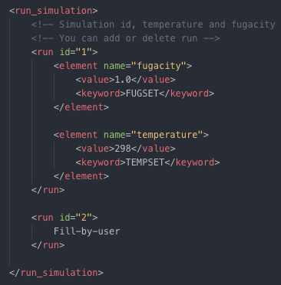
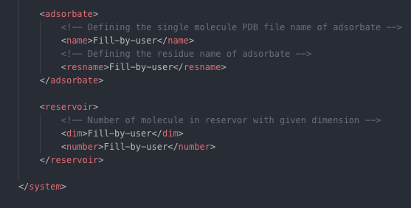
Task 1: Modifying the ConfigSetup.xml
Here are the fields that need to be changed in the XML files:
Notes:
Show them where they need to modify

Slide 21
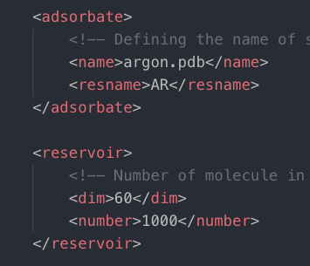
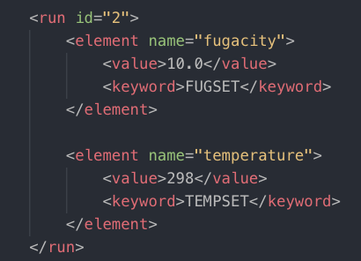
Task 1: Modifying the ConfigSetup.xml
Here is the correct changes to the XML files:
Now run the simulation_setup.py to generate the simulation files.
Follow the README.txt
Notes:
Make sure everyone have modified the xml file correctly

Slide 22
HTS directory setup
run_files
EDUSIF
common
RUN1
RUN2
MOF_base
reservoir_base
...
...
Notes:
Show them how HTS will setup the directory for them

Slide 23
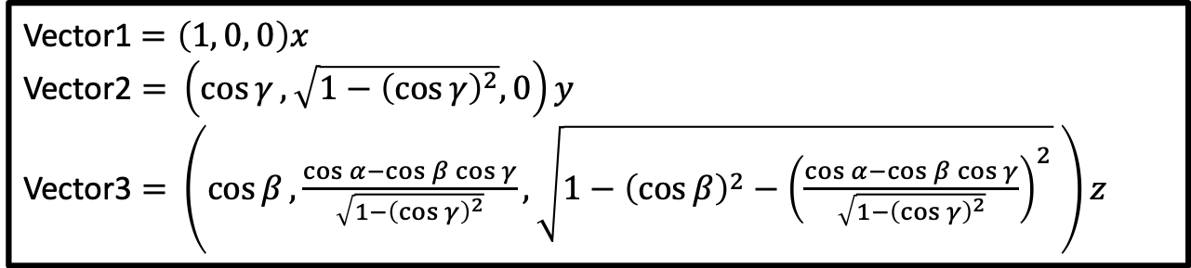
Control file: GCMC
# INPUT PDB, PSF FILES
Coordinates 0 ../common/MOF_base/EDUSIF_BOX_0.pdb
Coordinates 1 ../common/reservoir_base/START_BOX_1.pdb Structure 0 ../common/MOF_base/EDUSIF_BOX_0.psf
Structure 1 ../common/reservoir_base/START_BOX_1.psf
# MOVE FREQUENCY
DisFreq 0.30
RotFreq 0.20
SwapFreq 0.50
# Chemical Potential/Fugacity
Fugacity AR 1.0
Fugacity EDUS 0.0
# BOX DIMENSION #, X, Y, Z
CellBasisVector1 0 36.5320 0.0000 0.0000
CellBasisVector2 0 18.2660 31.6376 0.0000
CellBasisVector3 0 18.2660 10.5459 29.8283
CellBasisVector1 1 60 0.00 0.00
CellBasisVector2 1 0.00 60 0.00
CellBasisVector3 1 0.00 0.00 60
# OutHistSettings
DistName dis
HistName his
RunNumber 1
RunLetter a
SampleFreq 200
Vector1$=\left(1, 0, 0\right)x$
Vector2 $=$ $\left(\cos{γ}, \sqrt{1−{\left(\cos{γ}\right)}^{2}}, 0\right)y$
Vector3 $=$ $\left(\cos{β}, \frac{\cos{α}−\cos{β\cos{γ}}}{\sqrt{1−{\left(\cos{γ}\right)}^{2}}},\sqrt{1−{\left(\cos{β}\right)}^{2}−{\left(\frac{\cos{α}−\cos{β\cos{γ}}}{\sqrt{1−{\left(\cos{γ}\right)}^{2}}}\right)}^{2}} \right)z$
Notes:
Ask them to take a look a the config file for run_files/EDUSIF/RUN1-FUGACITY-1.0-TEMPERATURE-298/in.conf

Slide 24
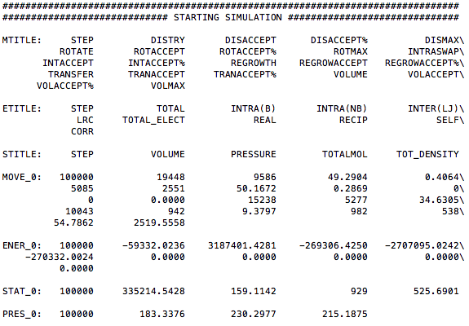
GOMC I/O: LOG Output
80
Notes:
Before extracting the data, show tell them about console output

Slide 25
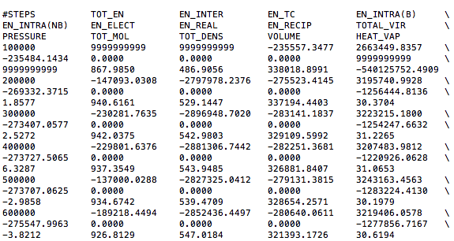
GOMC I/O: BLOCK Output
Notes:
Before extracting the data, show tell them about Block output

Slide 26
GOMC I/O: LOG Output
MOVE_<box number>: move statistics
ENER_<box number>: energies
STAT_<box number>: density
Data are stored in columns, making them straightforward to extract with awk.
Quantities are instantaneous values, and are defined with MTITLE, ETITLE and STITLE headers near the beginning of the log file.
Notes:
Talk about output file when Production is running!

Slide 27
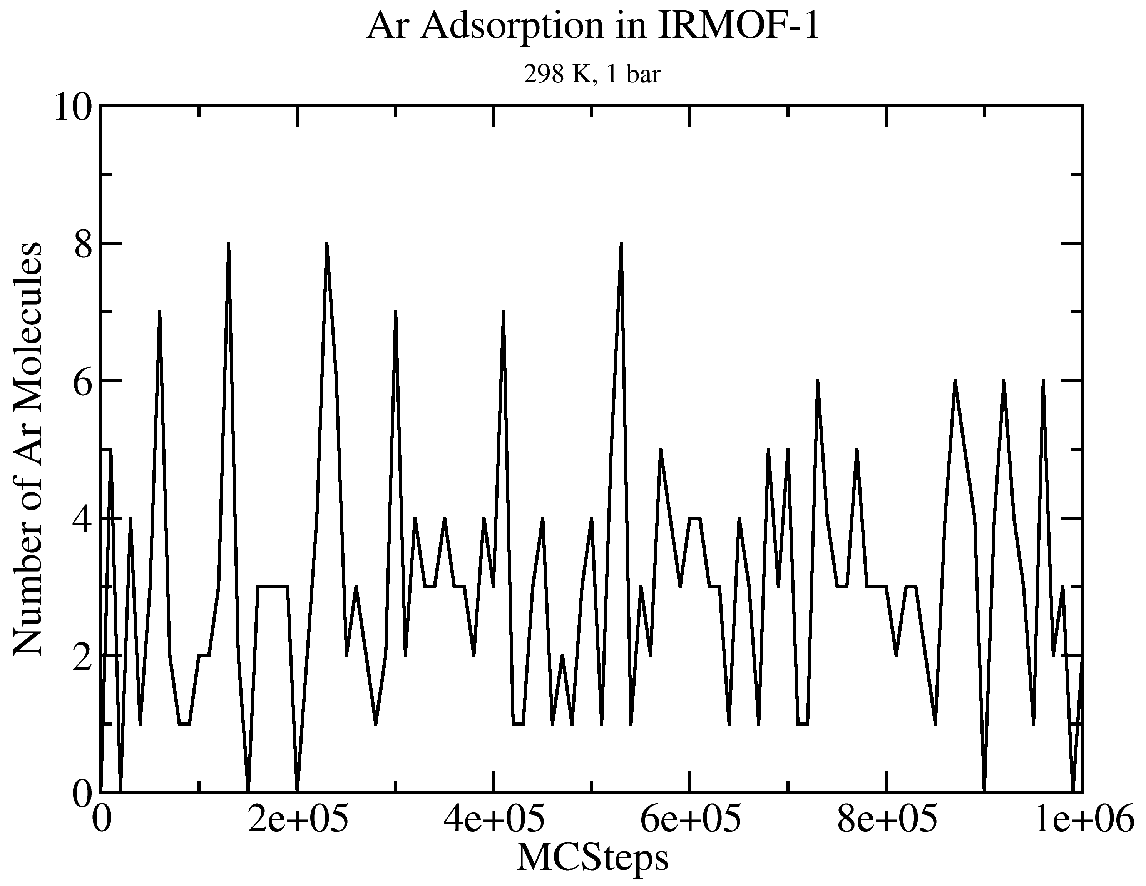
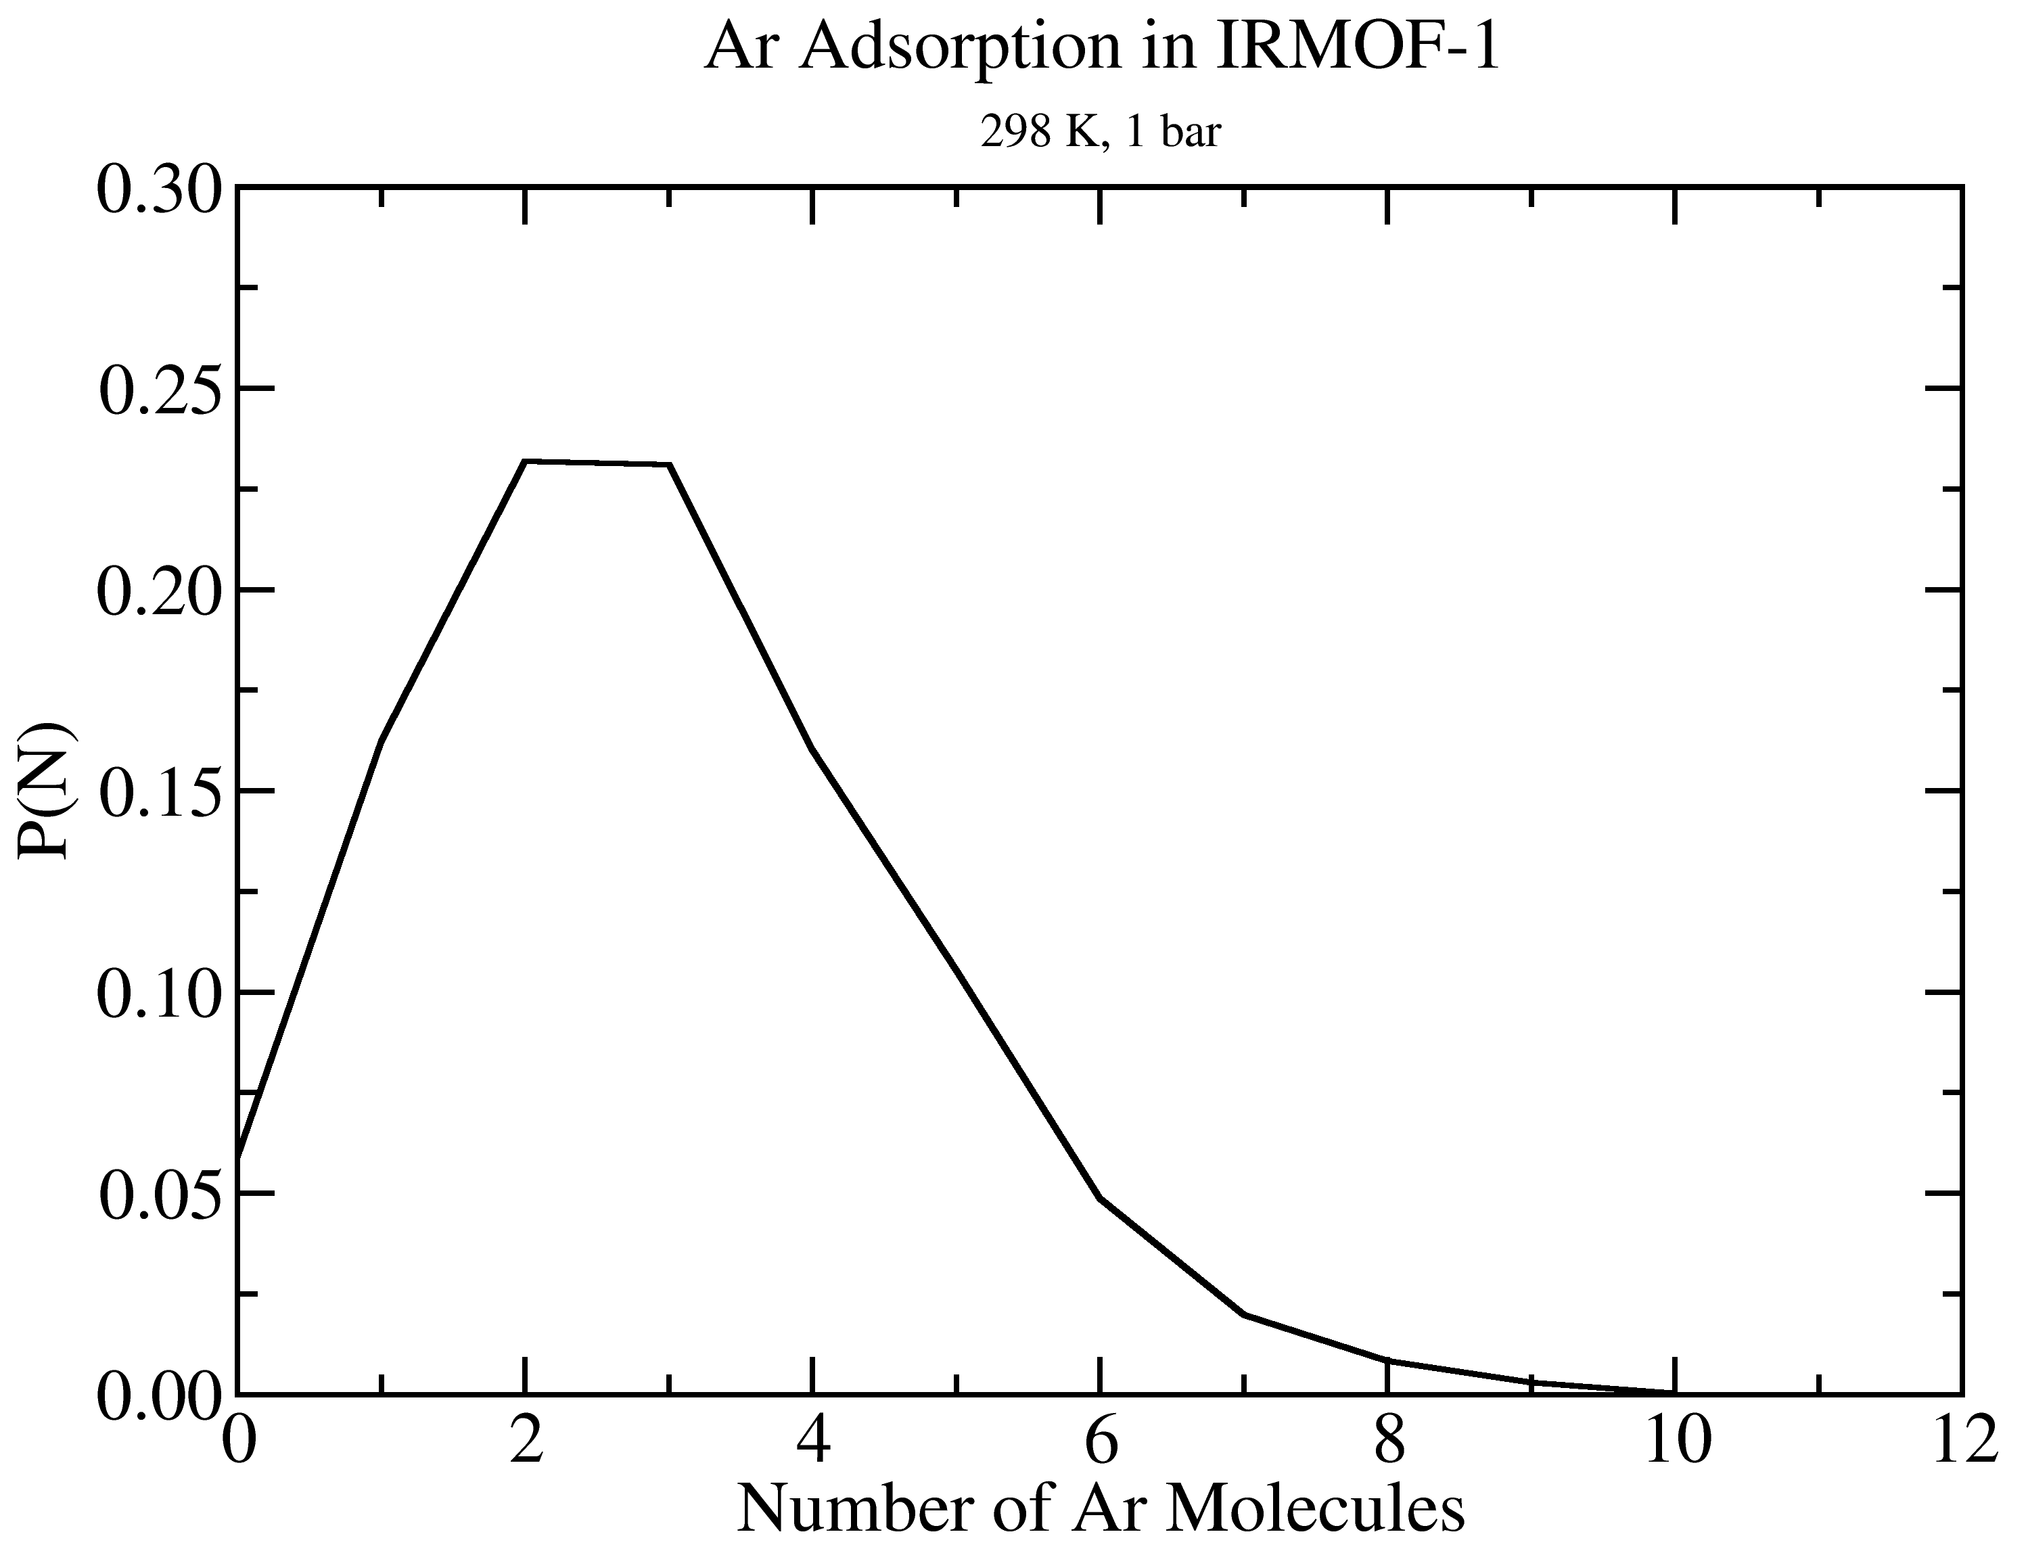
GOMC I/O: GCMC
Extract data using awk
cat output_AR.log | awk '/STAT_0/ {print $2, $3*$5}' > mol_AR_fluct.dat

Slide 28
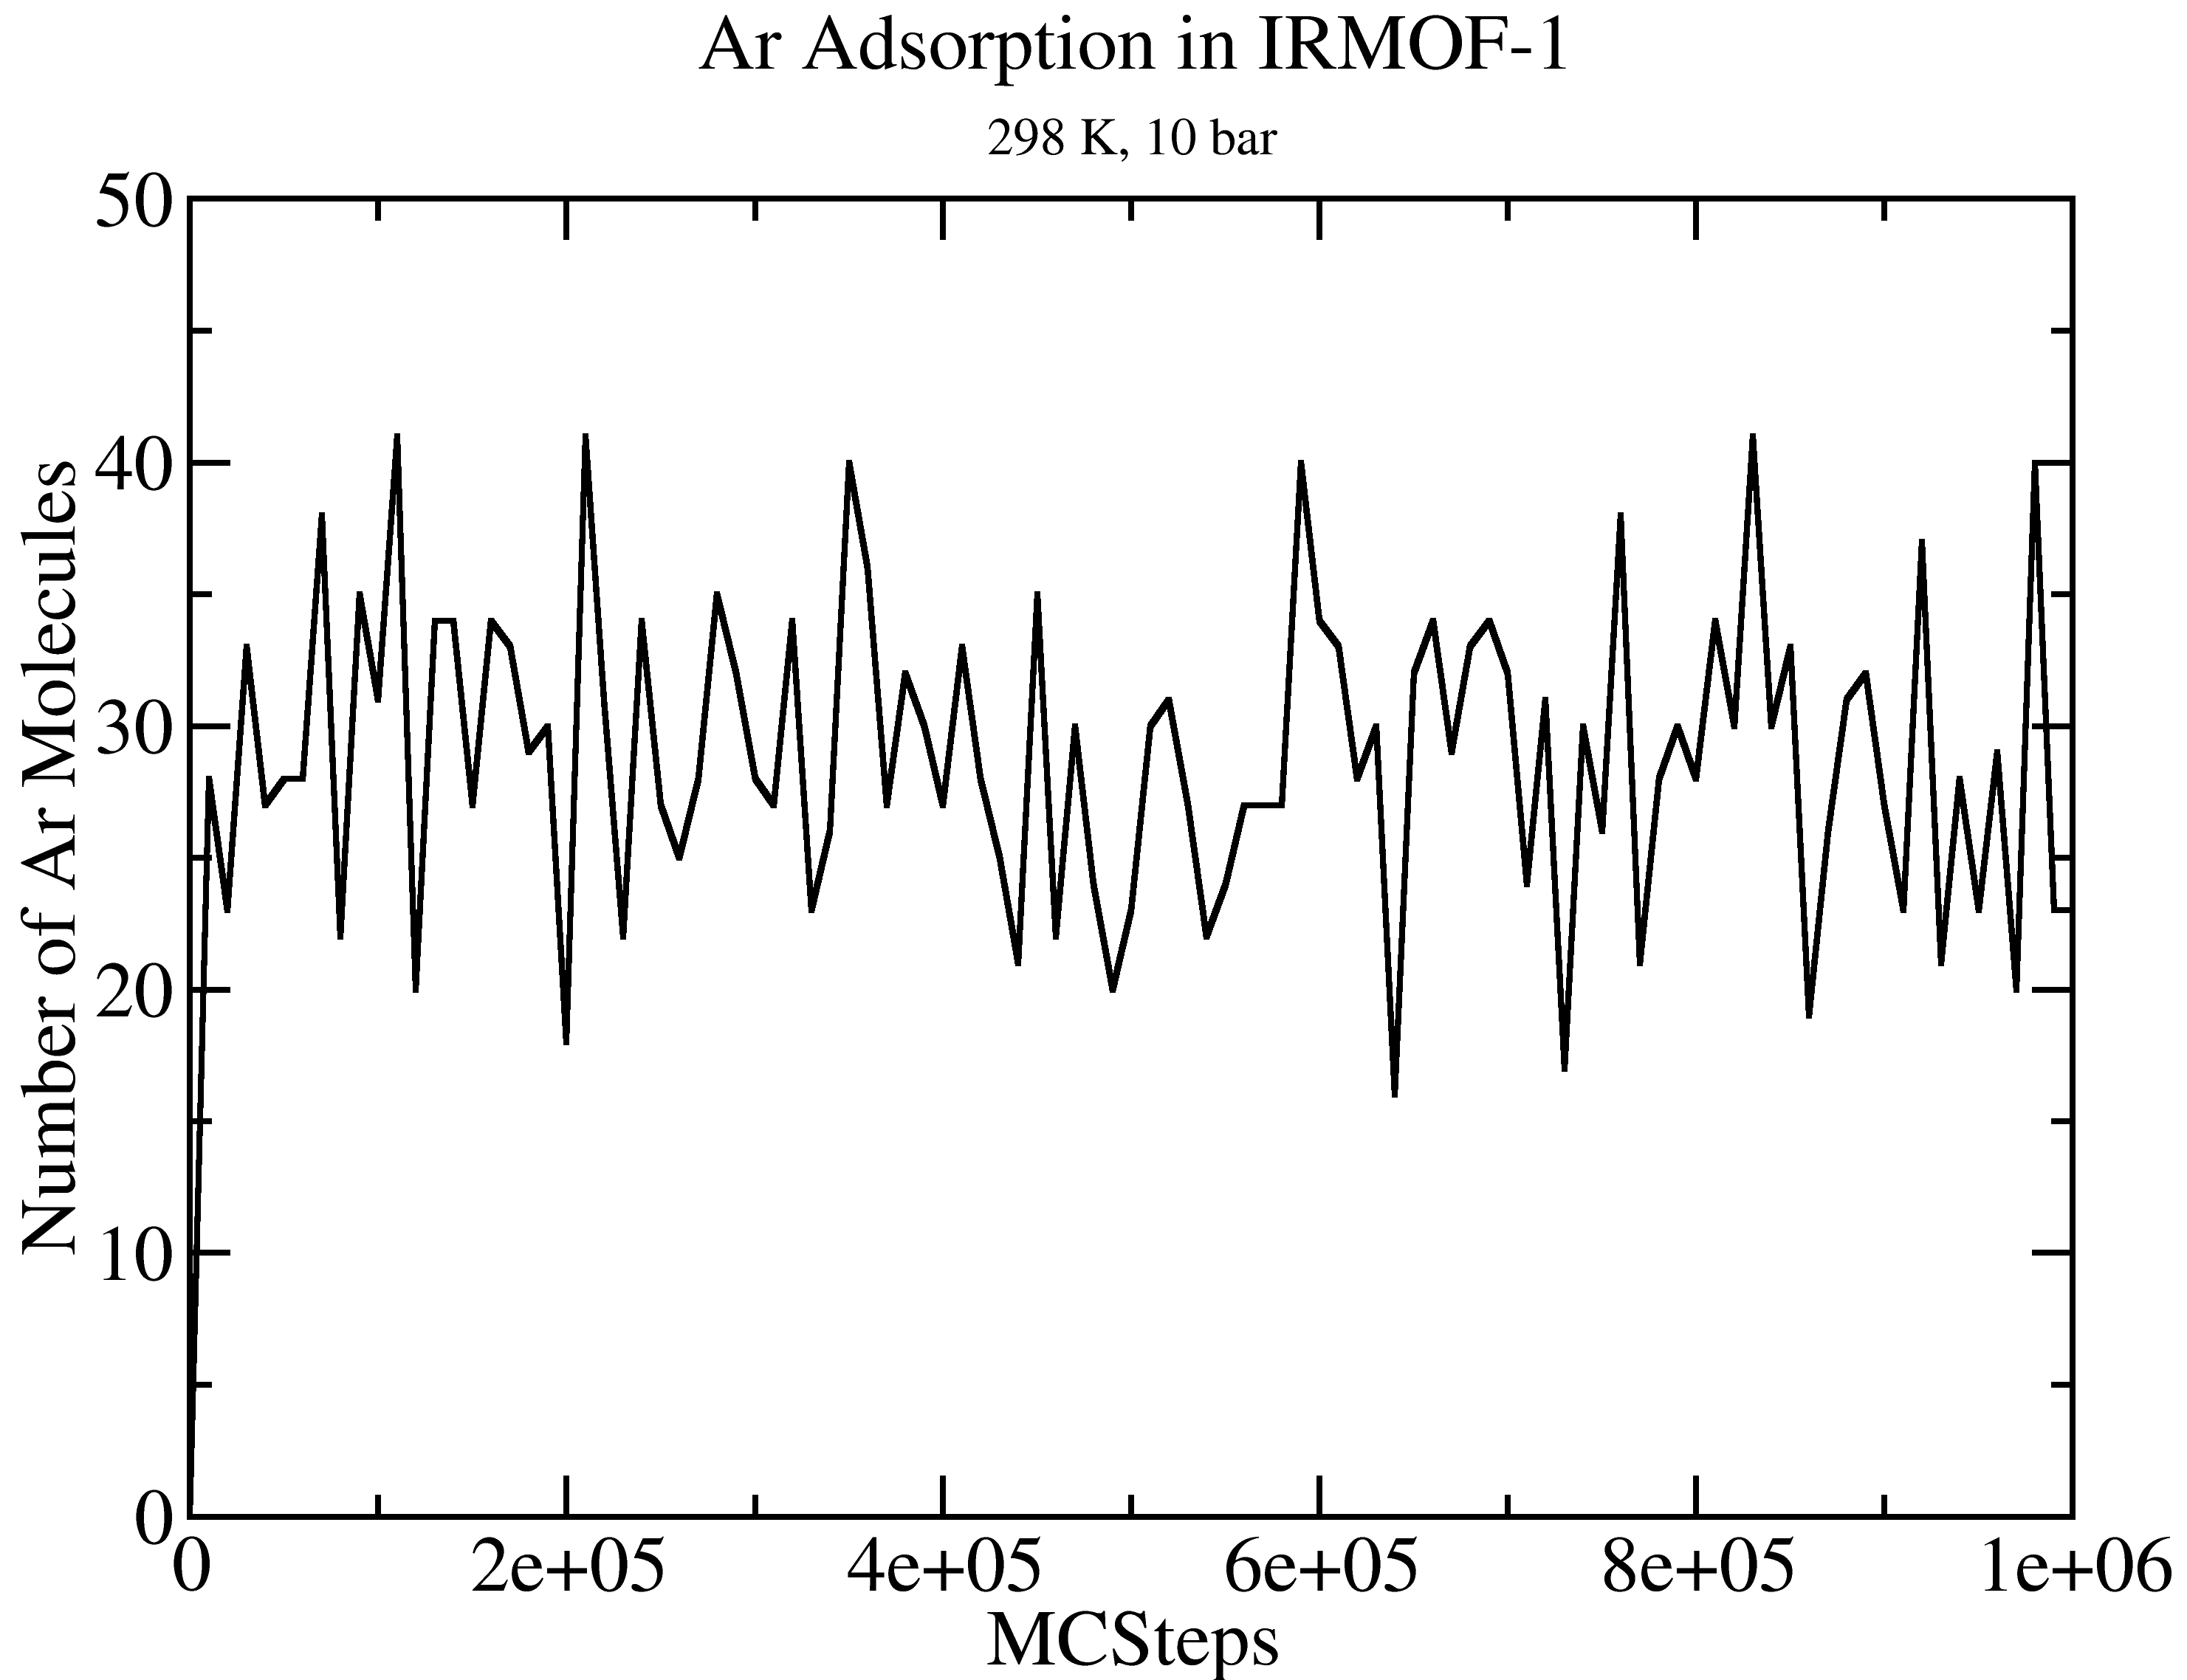
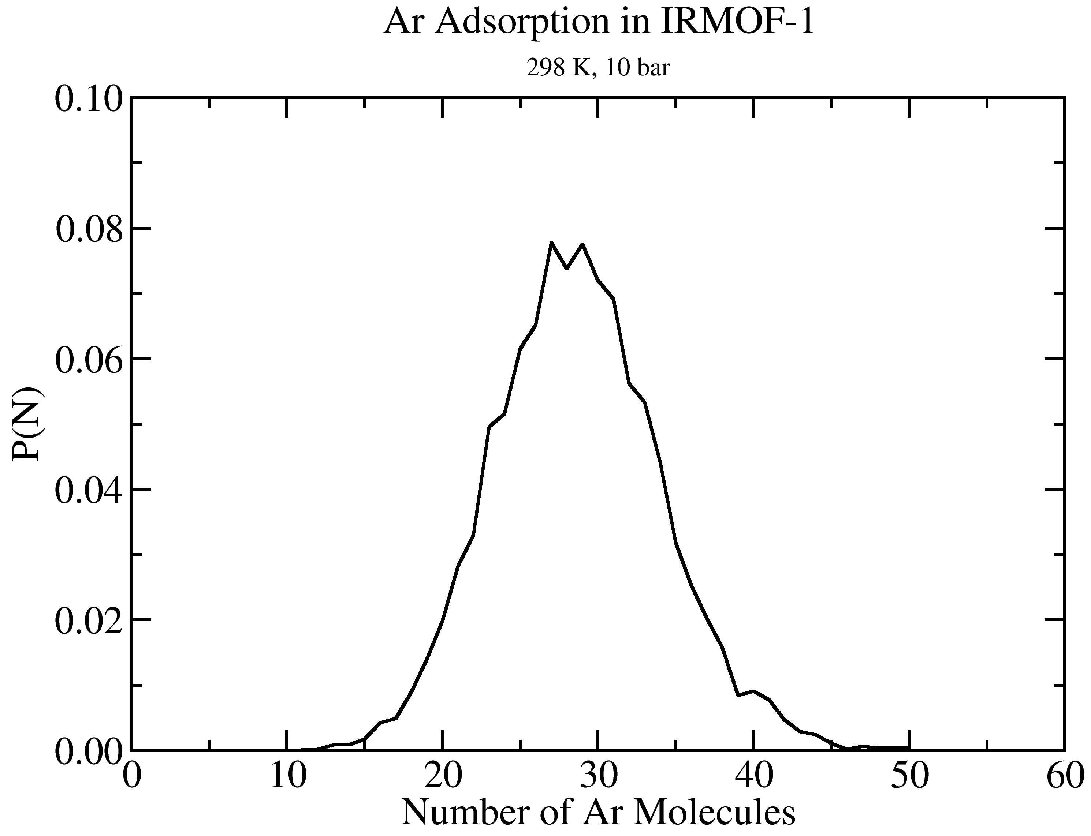
GOMC I/O: GCMC
Extract data using awk
cat output_AR.log | awk '/STAT_0/ {print $2, $3*$5}' > mol_AR_fluct.dat

Slide 29
Generate PDB, PSF file for reservoir:
Single molecule
PDB file
HTS
Pack the adsorbate molecules
Create PDB for reservoir
Create PSF for reservoir
Topology file
PACKMOL
VMD
Notes:
HTS need the single molecule PDB and topology file for adsorbate, to generate the PDB and PSF file.

Slide 30
Add New Adsorbate to HTS:
BUILD/
. . .
pdb/
model/
Add a single adsorbate PDB file to this directory.
Top_adsorbate.inp
Parameters_Universal.par
Add adsorbate topology to this file.
Add force field parameter this file.
Notes:
There are more directories in the BUILD, but to add a new adsorbate, we just need to:
1- Add single pdb file to “pdb” directory
2- Add the adsorbate topology and parameter file

Slide 31
Task 2: Add CO₂ adsorbate to HTS
Go to adsorption/CO2_IRMOF1/.
We already added the single CO₂ pdb file (carbondioxide.pdb) to “BUILD/” directory
You need to add the CO₂ topology to “BUILD/model/Top_adsorbate.inp”
You need to add the CO₂ force field parameters to “BUILD/model/Parameters_Universal.par”
REMARK Single pdb file for carbon dioxide
ATOM 1 O1 CO2 A 1 00.000 00.000 00.000 1.00 0.00 CO2 O
ATOM 2 C1 CO2 A 1 01.160 00.000 00.000 1.00 0.00 CO2 C
ATOM 3 O2 CO2 A 1 02.320 00.000 00.000 1.00 0.00 CO2 O

Slide 32
Topology file
RESI SPCE 0.00
GROUP
ATOM O1 OT -0.847600 ! O1
ATOM H1 HT 0.423800 ! / \
ATOM H2 HT 0.423800 ! H1 H2
BOND O1 H1 O1 H2
PATCHING FIRS NONE LAST NONE
Defines residue name
Maps atom name to atom type
Column 3 is the partial charge
Defines bonds between pairs of atoms.
Partial charges
Atom name
Atom type
Notes:
Teach them about topology file

Slide 33
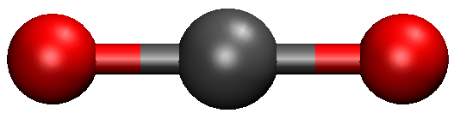
Task 2.1: Add CO₂ topology to Top_adsorbate.inp
Open to “BUILD/molel/Top_adsorbate.inp” with a text editor.
Replace “Fill-by-user” with the correct structural information.
RESI CO2 0.00 !
GROUP
Fill-by-user
PATCHING FIRS NONE LAST NONE
name: O1
type: O2C
Charge: -0.35
name: C1
type: CO2
Charge: +0.70
name: O2
type: O2C
Charge: -0.35
Resname CO2

Slide 34
Task 2.1: Add CO₂ topology to Top_adsorbate.inp
Here is the correct changes to the Top_adsorbate.inp file:
RESI CO2 0.00 ! GROUP
ATOM O1 O2C -0.35
ATOM C1 CO2 0.70
ATOM O2 O2C -0.35
BOND O1 C1 C1 O2
PATCHING FIRS NONE LAST NONE
name: O1
type: O2C
Charge: -0.35
name: C1
type: CO2
Charge: +0.70
name: O2
type: O2C
Charge: -0.35

Slide 35
Task 2: Add CO₂ adsorbate to HTS
Go to adsorption/CO2_IRMOF1/.
We already added the single CO₂ pdb file (carbondioxide.pdb) to “BUILD/” directory
We added the CO₂ topology to “BUILD/model/Top_adsorbate.inp”
You need to add the CO₂ force field parameters to “BUILD/model/Parameters_Universal.par”
Notes:
Transition to what to do next, setting up the parameter file

Slide 36
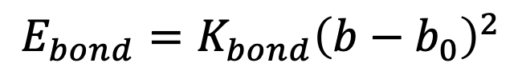
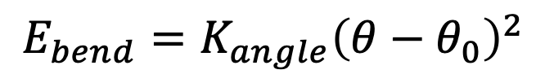
Parameter file: Bonds and Angles
BONDS
!
!V(bond) = Kb(b - b0)**2
!
!atom type Kb(K/mole/A**2) b0 (A) description
OT HT 9999999999 1.000 ! Fixed.
ANGLES
!
!V(angle) = Ktheta(Theta - Theta0)**2!
!
!atom types Ktheta(K/mole/rad**2) Theta0(degree)
HT OT HT 9999999999 109.50 ! fixed
$$E_{bond}=K_{bond}{\left(b−b_{0}\right)}^{2}$$
$$E_{bend}=K_{angle}{\left(θ−θ_{0}\right)}^{2}$$
Notes:
Teach them how to set the bonds and angle parameter, specially how to fix the bond and angle.

Slide 37
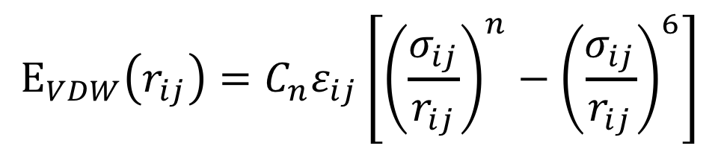
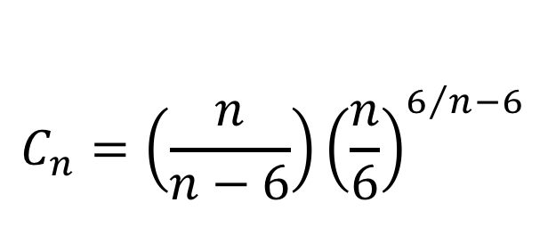
Parameter file: Nonbonded
EXOTIC
NONBONDED_MIE
!
! V(mie) = 4*eps*((sig_ij/r_ij)**n-(sig_ij/r_ij)**6)
!
!atom type eps(K) sigma(A) n eps,1-4(K) sigma,1-4(A) n,1-4 !description
OT 78.2054 3.167 12 0.00 0.000 0 ! SPCE
HT 0.0000 0.000 12 0.00 0.000 0 ! SPCE
$$E_{VDW}\left(r_{ij}\right)=C_{n}ε_{ij}\left[{\left(\frac{σ_{ij}}{r_{ij}}\right)}^{n}−{\left(\frac{σ_{ij}}{r_{ij}}\right)}^{6}\right]$$
$$C_{n}=\left(\frac{n}{n−6}\right){\left(\frac{n}{6}\right)}^{6/n−6}$$
Notes:
Teach them how to set the nonbonded parameters

Slide 38
Task 2.2: Add CO₂ force field parameter to Parameters_Universal.par
Open to “BUILD/model/Parameters_Universal.par” with a text editor.
Replace “Fill-by-user” with the correct bonded and non-bonded parameters.
BONDS
!atom type Kb b0
Fill-by-user
type: O2C
type: CO2
type: O2C
ANGLES
!atom types Ktheta Theta0
Fill-by-user
O-C bond: 1.16 A, fix
O-C-O angle: 180, fix
NONBONDED_MIE
! Atom type eps sig n eps1-4 sig1-4 n1-4
Fill-by-user

Slide 39
Task 2.2: Add CO₂ force field parameter to Parameters_Universal.par
Here is the correct changes to the Parameters_Universal.par file:
BONDS
!atom type Kb b0
CO2 O2C 9999999999999 1.16
type: O2C
type: CO2
type: O2C
ANGLES
!atom types Ktheta Theta0
O2C CO2 O2C 9999999999999 180.00
O-C bond: 1.16 A, fix
O-C-O angle: 180, fix
NONBONDED_MIE
! Atom type eps sig n eps1-4 sig1-4 n1-4
O2C 79.00 3.050 12 0.0 0.0 0.0
CO2 27.00 2.800 12 0.0 0.0 0.0

Slide 40
Task 2: Add CO₂ adsorbate to HTS
Go to adsorption/CO2_IRMOF1/.
We already added the single CO₂ pdb file (carbondioxide.pdb) to “BUILD/” directory
We added the CO₂ topology to “BUILD/model/Top_adsorbate.inp”
We added the CO₂ force field parameters to “BUILD/model/Parameters_Universal.par”
Now run the simulation_setup.py to generate the simulation files.
Follow the README.txt
Notes:
Transition to what to do next, setting up the simulation files

Slide 41
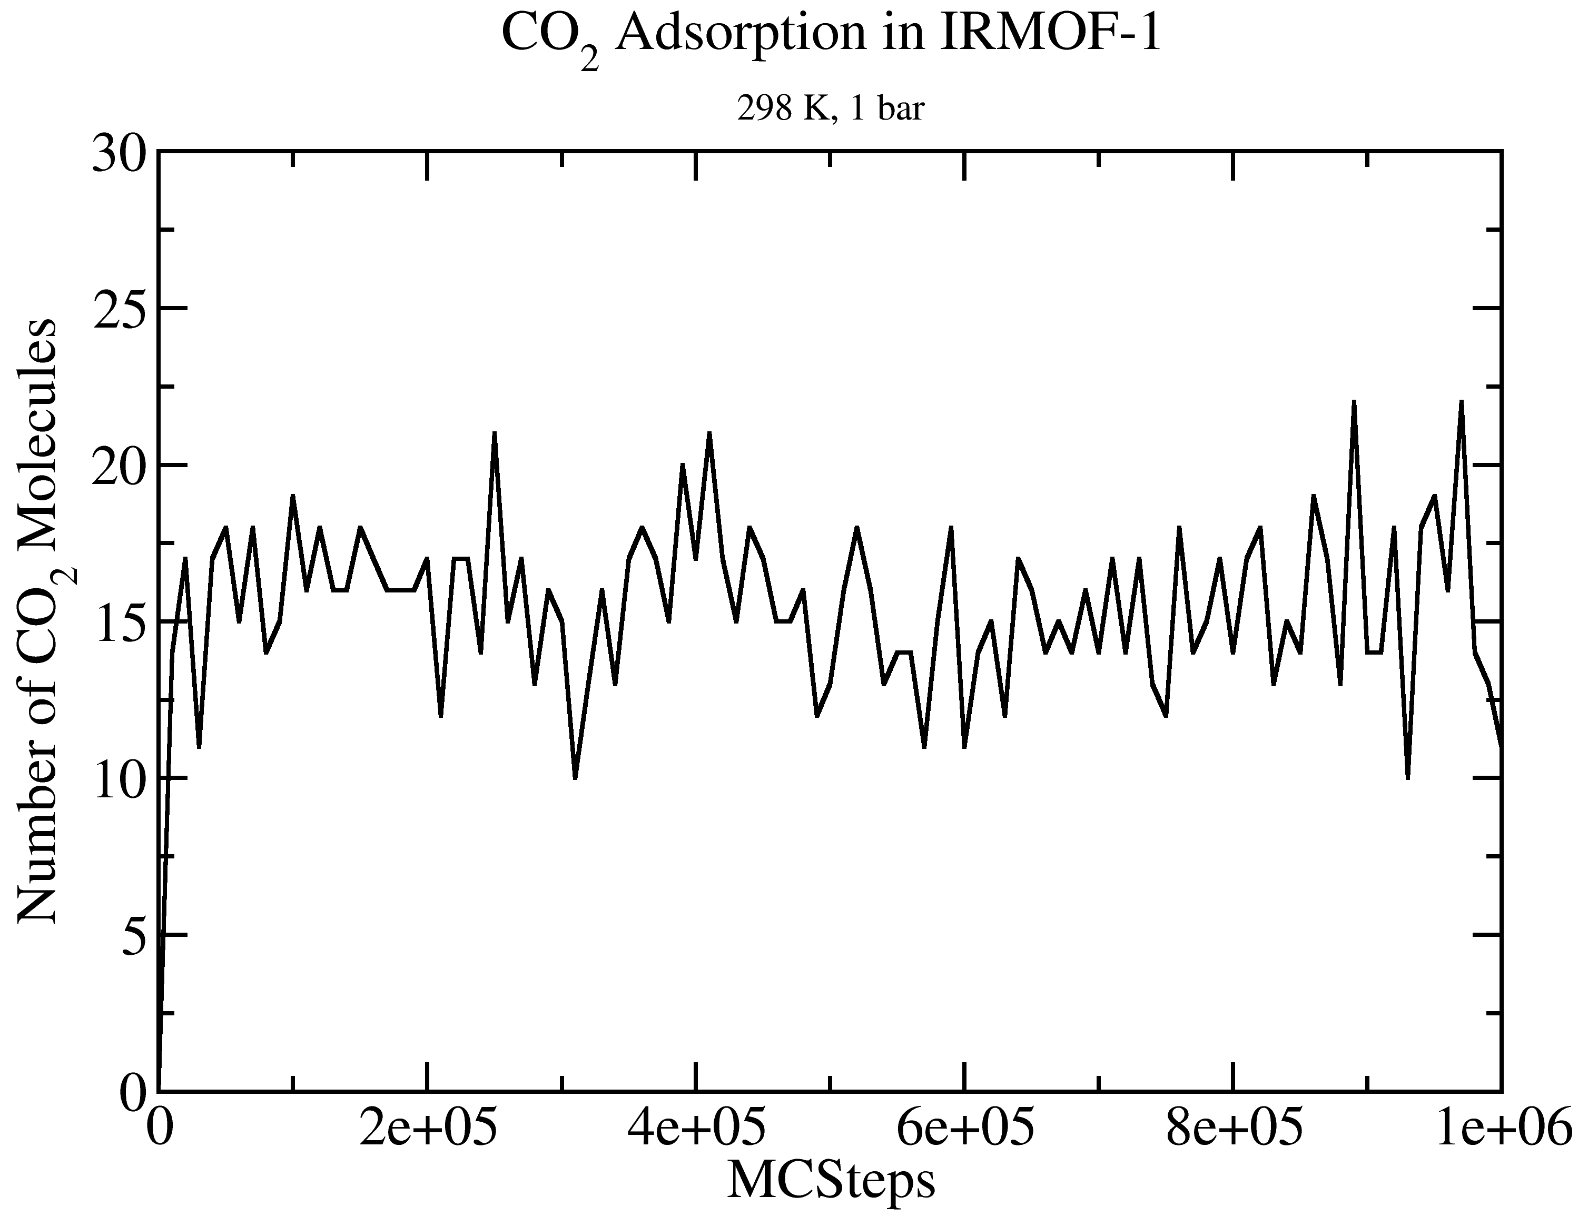
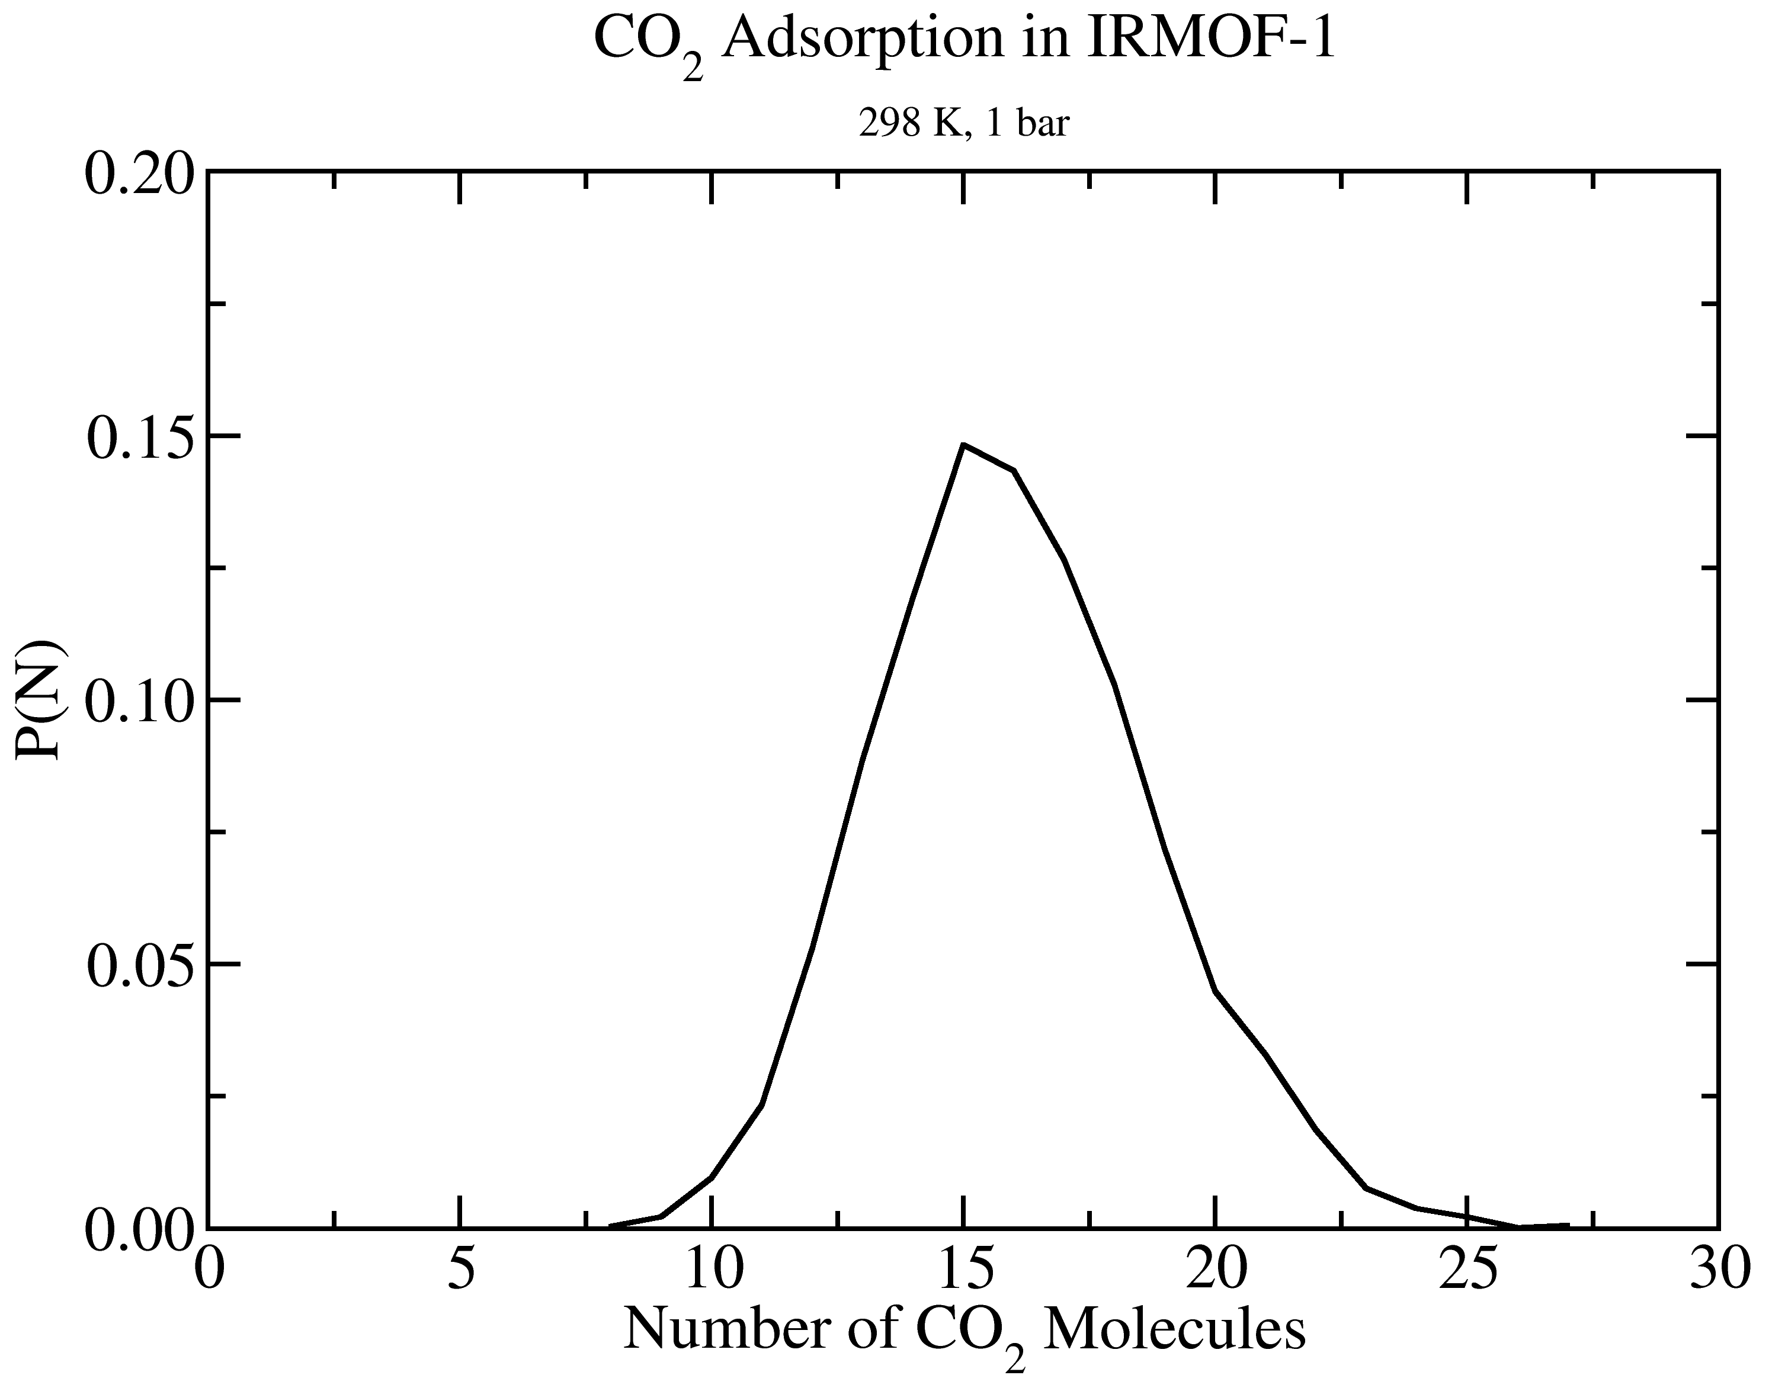
GOMC I/O: GCMC
Extract data using awk
cat output_CO2.log | awk '/STAT_0/ {print $2, $3*$5}' > mol_CO2_fluct.dat

Slide 42
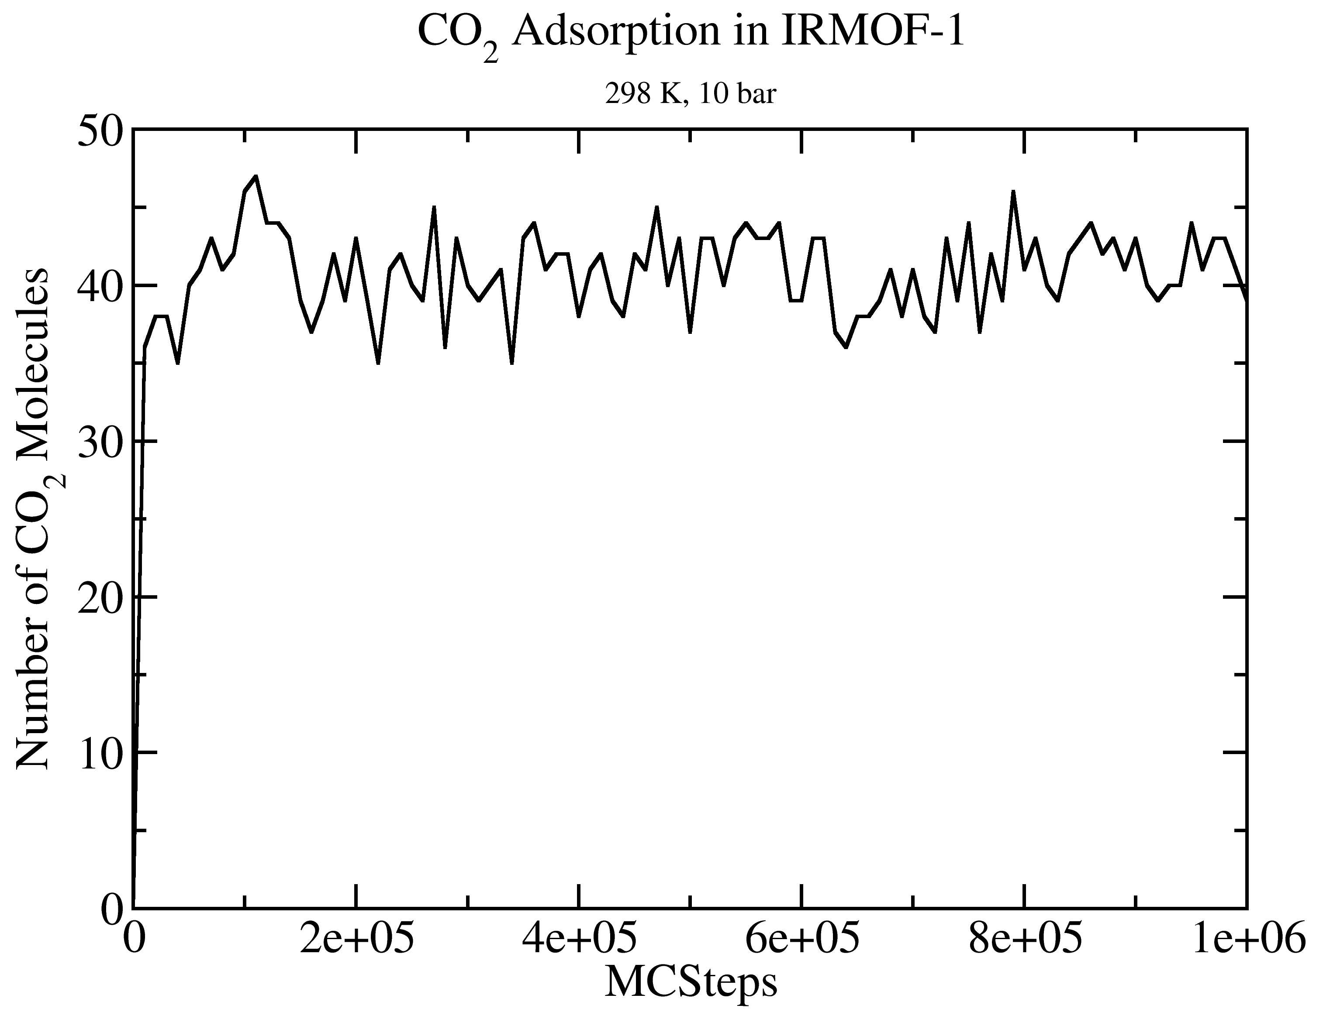
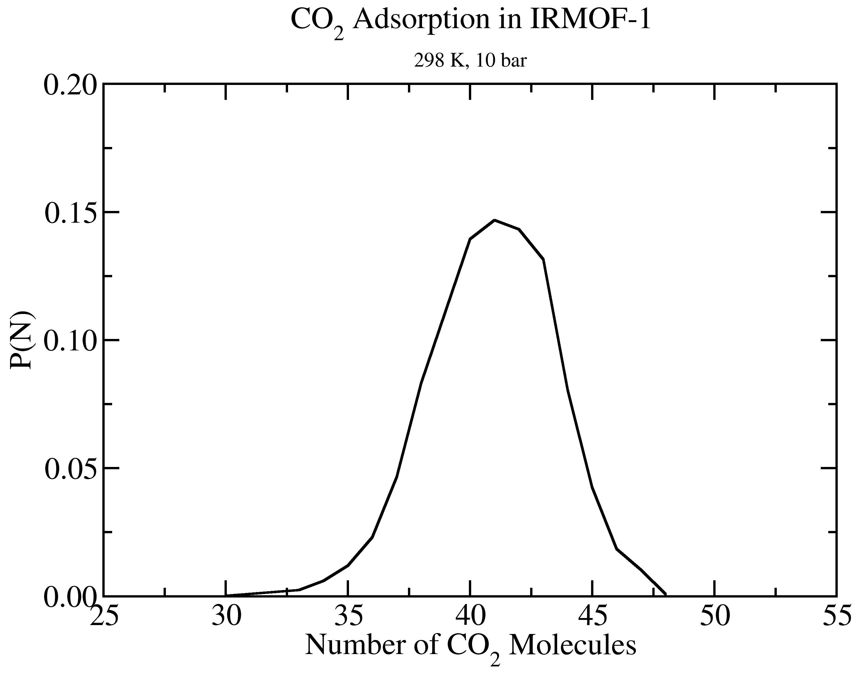
GOMC I/O: GCMC
Extract data using awk
cat output_CO2.log | awk '/STAT_0/ {print $2, $3*$5}' > mol_CO2_fluct.dat

Slide 43
Free Energy Calculation

Slide 44
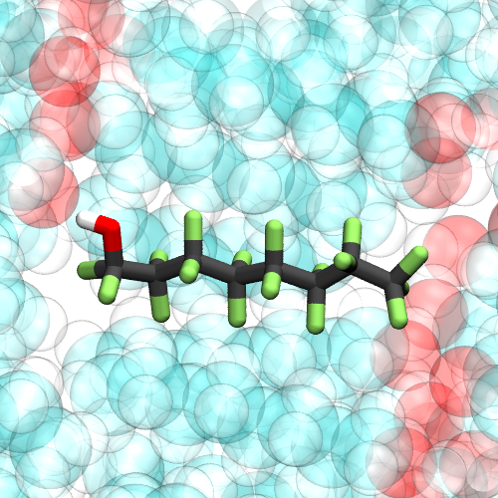
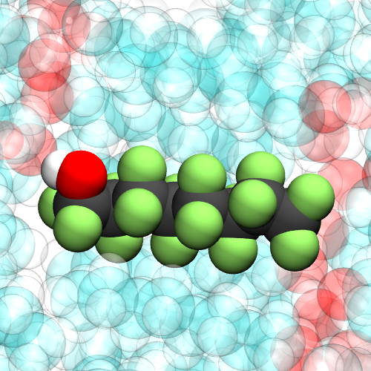

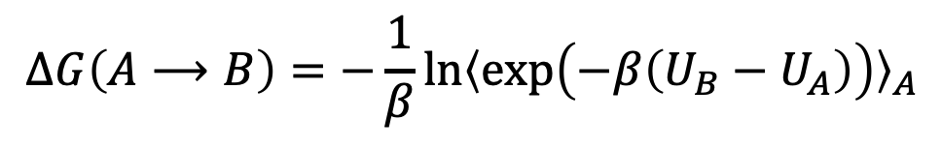
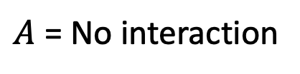
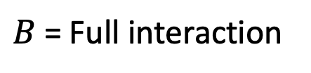
Free energy calculation: FEP
$$∆G\left(A⟶B\right)=−\frac{1}{β}\ln{{〈\exp\left(−β\left(U_{B}−U_{A}\right)\right)〉}_{A}}$$
$A$ = No interaction
$B$ = Full interaction

Slide 45
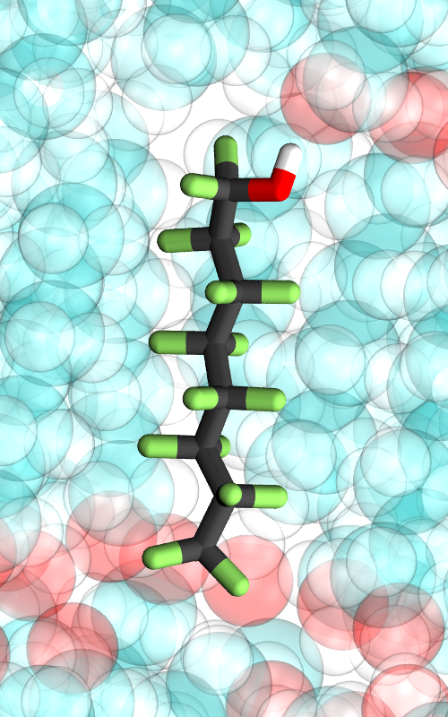
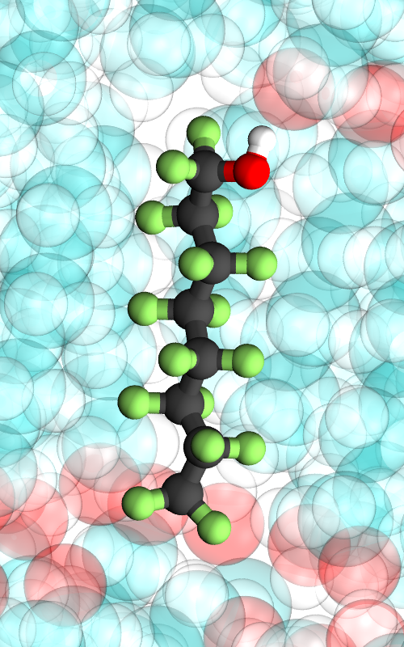











Free energy calculation: FEP/TI
$$∆G\left(A⟶B\right)=−\frac{1}{β}\sum_{i=0}^{N−1}{\ln{{〈\exp\left(−β\left(U_{i+1}−U_{i}\right)\right)〉}_{i}}}$$
$$∆G\left(A⟶B\right)=\int_{λ=0}^{λ=1}{{〈\frac{dU}{dλ}〉}_{λ}dλ}$$
$$A\left(λ_{0}=0\right)$$
$$<$$
$$λ_{1}$$
$$< . . . . <$$
$$λ_{N−1}$$
$$<$$
$$B\left(λ_{N}=1\right)$$

Slide 46


Free energy calculation: Scale nonbonded Interaction
$$U_{λ}\left(r_{ij}\right)=λ_{LJ}U_{LJ}\left(r_{sc−ij}\right)+λ_{Coul}U_{Coul}\left(r_{ij}\right)$$
$$r_{sc−ij}={\left(α{\left(1−λ_{LJ}\right)}^{p}{σ_{ij}}^{6}+{r_{ij}}^{6}\right)}^{1/6}$$
Figure: T. Steinbrecher, I. Joung, and D. A. Case, J. Comput. Chem. 32 (15), 3253 (2011).

Slide 47







Free energy calculation: FEP/TI
$$U_{LJ}\left(r_{ij}\right)=4 ε_{ij}\left[{\left(\frac{σ_{ij}}{r_{ij}}\right)}^{12}−{\left(\frac{σ_{ij}}{r_{ij}}\right)}^{6}\right]$$
$$U_{Coul}\left(r_{ij}\right)=\frac{q_{i}q_{j}}{4πε_{o}r_{ij}}$$
$$r_{sc−ij}={\left(α{\left(1−λ_{LJ}\right)}^{p}{σ_{ij}}^{6}+{r_{ij}}^{6}\right)}^{1/6}$$
$$U_{λ}\left(r_{ij}\right)=λ_{LJ}U_{LJ}\left(r_{sc−ij}\right)+λ_{Coul}U_{Coul}\left(r_{ij}\right)$$
$$\frac{dU_{λ}\left(r_{ij}\right)}{dλ_{LJ}}=U_{LJ}\left(r_{sc−ij}\right)+\frac{λ_{LJ}pα}{6}{\left(1−λ_{LJ}\right)}^{p−1}\left(\frac{{σ_{ij}}^{6}}{{r_{ij}}^{5}}\right)F_{LJ}\left(r_{sc−ij}\right)$$
$$\frac{{dU}_{Coul}\left(r_{ij}\right)}{dλ_{Coul}}=U_{Coul}\left(r_{ij}\right)$$
$$F_{LJ}\left(r_{ij}\right)=−\frac{{dU}_{LJ}\left(r_{ij}\right)}{dr_{ij}}=\frac{4ε_{ij}}{r_{ij}}\left[12{\left(\frac{σ_{ij}}{r_{ij}}\right)}^{12}−{6\left(\frac{σ_{ij}}{r_{ij}}\right)}^{6}\right]$$

Slide 48
Free energy calculation: FEP/TI
Solvation free energy of Ne in cyclohexane at 298 K and 1.0 bar
NVT simulation in 4 intermediate states
Calculate Ne solvation free energy in cyclohexane with alchemlyb
Calculate Ne solvation free energy in cyclohexane with alchemical-analysis
Solvation free energy of Ar in cyclohexane at 298 K and 1.0 bar
Setup GOMC config file and run NVT simulation in 4 intermediate states
Calculate Ar solvation free energy in cyclohexane with alchemlyb
Calculate Ar solvation free energy in cyclohexane with alchemical-analysis
https://github.com/alchemistry/alchemlyb
https://github.com/msoroush/alchemical-analysis

Slide 49




Free energy calculation: Simulation Process
Pack solvent + 1 solute
alchemlyb,
alchemical-analysis
NVT at 298 K
NVT at 298 K,
$$λ_{i}$$
NPT at 298 K,
1.0 bar
NPT at 298 K,
1.0 bar, $λ_{i}$
https://github.com/msoroush/alchemical-analysis
https://github.com/alchemistry/alchemlyb
Notes:
Green box means, we already performed the simulation
Red box means, they should do it in the workshop

Slide 50


Control file: Free Energy calculation
Restart true
Coordinates 0 ./EQ_BOX_0_restart.pdb
Structure 0 ./EQ_merged.psf
# FREE ENERGY PARAMETER
FreeEnergyCalc true 1000
MoleculeType NE 1
InitialState 1
ScalePower 2
ScaleAlpha 0.5
MinSigma 3.0
ScaleCoulomb false
LambdaVDW 0.00 0.20 0.40 0.60 0.8 1.00 1.00 1.00 1.00 1.00 1.00
LambdaCoulomb 0.00 0.00 0.00 0.00 0.00 0.00 0.20 0.40 0.60 0.80 1.00
$$r_{sc−ij}={\left(α{\left(1−λ_{LJ}\right)}^{p}{σ_{ij}}^{6}+{r_{ij}}^{6}\right)}^{1/6}$$
Notes:
You need to explain them which keyword means what. Most importantly, the initialState and LmabdaVDW keyword.

Slide 51
Task 1: Running free energy calculation simulation.
Go to freeEnergy/NE/.
Run the NVT simulation at 4 intermediate states. (Follow the README.txt)
states/state_0
states/state_1
states/state_2
states/state_3
Take a look at prod.conf file in each state to learn about free energy parameters.
FreeEnergyCalc true 1000
MoleculeType NE 1
ScalePower 2
ScaleAlpha 0.5
MinSigma 3.0
InitialState 0
LambdaVDW 0.00 0.22 0.70 1.00
FreeEnergyCalc true 1000
MoleculeType NE 1
ScalePower 2
ScaleAlpha 0.5
MinSigma 3.0
InitialState 3
LambdaVDW 0.00 0.22 0.70 1.00
. . .
Notes:
Teach them how in GOMC they can specify which intermediate states runs the NVT ( by setting InitialState 0, 1, … 3)

Slide 52

GOMC Free Energy Output
Table: Sample of GOMC free energy data
$T=298$ (K) |  | $$λ_{2}=(0.0, 0.2)$$
Steps | $$U_{total}$$ | $$\frac{dU_{coul}}{dλ_{2, coul}}$$ | $$\frac{dU_{LJ}}{dλ_{2, LJ}}$$ | $${∆U}_{2→0}$$ | $${∆U}_{2→1}$$ | $${∆U}_{2→2}$$ | … | $${∆U}_{2→15}$$ | $$PV$$
1000 | -8877.456 | -3.231 | 8.077 | 10.004 | 2.624 | 0.000 | … | 2266.677 | 3.181
2000 | -8835.898 | 2.683 | 110.732 | -0.256 | -4.425 | 0.000 | … | 47079.538 | 3.164
3000 | -8827.969 | 1.666 | 245.945 | -14.514 | -14.142 | 0.000 | … | 19780.139 | 3.188
… | … | … | … | … | … | … | … | … | …
10000 | -8819.957 | -11.471 | 37.901 | 6.680 | 0.422 | 0.000 | … | 1383.572 | 3.171
Notes:
Teach them how GOMC will calculate the du/dlambda and change in energy between current states and all other states.
Tell them BAR estimator needs only change in energy between neighboring states, but MBAR needs between all other states

Slide 53
Task 2: Analysis the GOMC free energy outputs.
Go to freeEnergy/NE/result/.
Copy the free energy files into "data" directory
“cp ../states/state*/Free_Energy_BOX_0_PRODUCTION_*.dat ./data/.”
Calculate the solvation free energy with alchemlyb library
“python ./free_energy_calc.py”
Plot the solvation free energy with alchemical_analysis tool
“alchemical_analysis -a gomc -d data -p Free_Energy_BOX_0_PRODUCTION_ -q dat -g True -w True -f 10 -u 'kcal' -o plots -m '-DEXP-IEXP’ ”
Notes:
Tell them that they can copy and paste the command from README.txt file

Slide 54




Ne Solvation Free Energy: 4 States
Notes:
TI-CUBIC is a line fit to the du/dlambda, the reason is that it is off because we don’t have enough states to fit accurately.

Slide 55




Ne Solvation Free Energy: 10 States

Slide 56
Task 3: Setting up the free energy parameter in GOMC
Go to freeEnergy/AR/.
Open the “prod.conf” with a text editor and replace the “Fill-by-user” with correct value or values in the following directories.
states/state_0/.
states/state_1/.
states/state_2/.
states/state_3/.
Define the VDW lambda vector as: 0.00, 0.14, 0.45, 1.00
Set the initial state number for each simulation.
FreeEnergyCalc true 1000
MoleculeType AR 1
ScalePower 2
ScaleAlpha 0.5
MinSigma 3.0
InitialState Fill-by-user
LambdaVDW Fill-by-user
Notes:
They must define the VDW lambda and set the initial state to run the NVT simulation at this lambda

Slide 57
Task 3: Setting up the free energy parameter in GOMC
Here is the correct changes to the “prod.conf” file for each simulation:
state_0/prod.conf
state_1/prod.conf
FreeEnergyCalc true 1000
MoleculeType AR 1
ScalePower 2
ScaleAlpha 0.5
InitialState 0
LambdaVDW 0.00 0.14 0.45 1.00
FreeEnergyCalc true 1000
MoleculeType AR 1
ScalePower 2
ScaleAlpha 0.5
InitialState 1
LambdaVDW 0.00 0.14 0.45 1.00
states/state_2/prod.conf
states/state_3/prod.conf
FreeEnergyCalc true 1000
MoleculeType AR 1
ScalePower 2
ScaleAlpha 0.5
InitialState 2
LambdaVDW 0.00 0.14 0.45 1.00
FreeEnergyCalc true 1000
MoleculeType AR 1
ScalePower 2
ScaleAlpha 0.5
InitialState 3
LambdaVDW 0.00 0.14 0.45 1.00

Slide 58
Task 4: Analysis the GOMC free energy outputs.
Run the NVT simulation at 4 intermediate states. (Follow the README.txt)
Go to freeEnergy/AR/result/.
Copy the free energy files into "data" directory
“cp ../states/state*/Free_Energy_BOX_0_PRODUCTION_*.dat ./data/.”
Calculate the solvation free energy with alchemlyb library
“python ./free_energy_calc.py”
Plot the solvation free energy with alchemical_analysis tool
“alchemical_analysis -a gomc -d data -p Free_Energy_BOX_0_PRODUCTION_ -q dat -g True -w True -f 10 -u 'kcal' -o plots -m '-DEXP-IEXP’ ”
Notes:
Tell them that they can copy and paste the command from README.txt file

Slide 59




Ar Solvation Free Energy: 4 States
Notes:
TI-CUBIC is a line fit to the du/dlambda, the reason is that it is off because we don’t have enough states to fit accurately.

Slide 60




Ar Solvation Free Energy: 10 States

Slide 61

GOMC on Multicore and GPU

Slide 62
Acknowledgements
Jason Mick, Younes Nejahi, Kamel Rushaidat, Niloofar Torabi, Brock Jackman, Navendu Bhatnagar, Ganesh Kamath, Loren Schwiebert
National Science Foundation CBET-1066661, ACI-1148168, OAC-1642406
NVIDIA, Silicon Mechanics
Grid Computing at WSU

